Slide 1
UNIT III
EXCEPTION HANDLING AND I/O
Exceptions – exception hierarchy – throwing and catching exceptions – built-in exceptions, creating own exceptions, Stack Trace Elements. Input / Output Basics – Streams – Byte streams and Character streams – Reading and Writing Console – Reading and Writing Files

Slide 2
Exception Handling in Java
The Exception Handling in Java is one of the powerful mechanism to handle the runtime errors so that normal flow of the application can be maintained.
What is Exception in Java?
Dictionary Meaning: Exception is an abnormal condition.
In Java, an exception is an event that disrupts the normal flow of the program. It is an object which is thrown at runtime.

Slide 3
What is Exception Handling?
Exception Handling is a mechanism to handle runtime errors such as ClassNotFoundException, IOException, SQLException, RemoteException, etc.
Advantage of Exception Handling
The core advantage of exception handling is to maintain the normal flow of the application. An exception normally disrupts the normal flow of the application that is why we use exception handling. Let's take a scenario:

Slide 4
statement 1;
statement 2;
statement 3;
statement 4;
statement 5;//exception occurs
statement 6;
statement 7;
statement 8;
statement 9;
statement 10;
Suppose there are 10 statements in your program and there occurs an exception at statement 5, the rest of the code will not be executed i.e. statement 6 to 10 will not be executed. If we perform exception handling, the rest of the statement will be executed. That is why we use exception handling in Java.

Slide 5
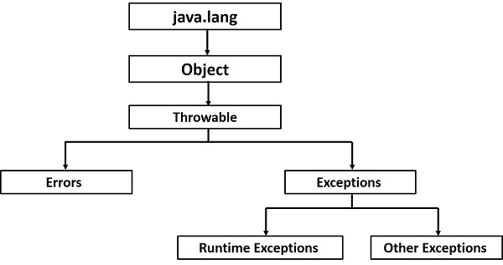
Hierarchy of Java Exception classes
The java.lang.Throwable class is the root class of Java Exception hierarchy which is inherited by two subclasses: Exception and Error. A hierarchy of Java Exception classes are given below:

Slide 6
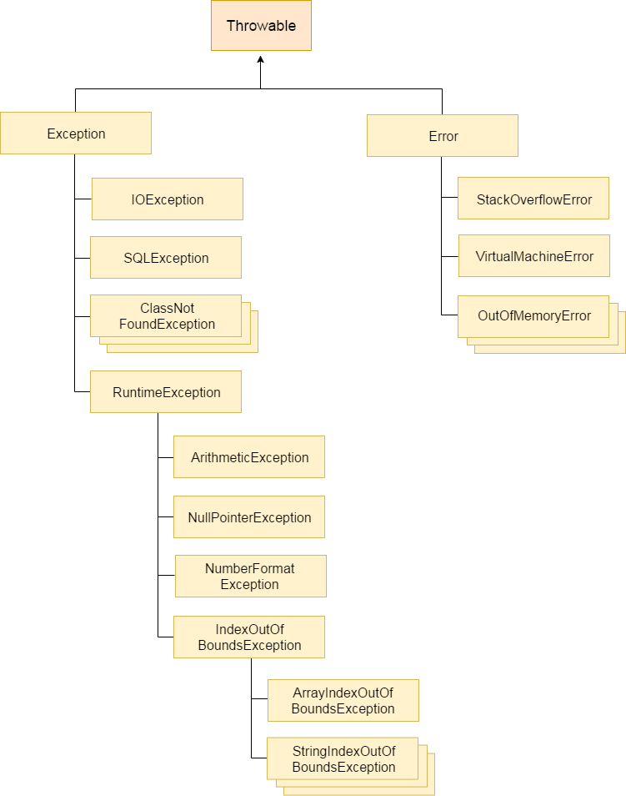

Slide 7
Types of Java Exceptions
There are mainly two types of exceptions: checked and unchecked. Here, an error is considered as the unchecked exception. According to Oracle, there are three types of exceptions:
Checked Exception
Unchecked Exception
Error

Slide 8
Difference between Checked and Unchecked Exceptions
1) Checked Exception
The classes which directly inherit Throwable class except RuntimeException and Error are known as checked exceptions e.g. IOException, SQLException etc. Checked exceptions are checked at compile-time.
2) Unchecked Exception
The classes which inherit RuntimeException are known as unchecked exceptions e.g. ArithmeticException, NullPointerException, ArrayIndexOutOfBoundsException etc. Unchecked exceptions are not checked at compile-time, but they are checked at runtime.
3) Error
Error is irrecoverable e.g. OutOfMemoryError, VirtualMachineError, AssertionError etc.

Slide 9
Java Exception Keywords
There are 5 keywords which are used in handling exceptions in Java.
Keyword | Description
try | The "try" keyword is used to specify a block where we should place exception code. The try block must be followed by either catch or finally. It means, we can't use try block alone.
catch | The "catch" block is used to handle the exception. It must be preceded by try block which means we can't use catch block alone. It can be followed by finally block later.
finally | The "finally" block is used to execute the important code of the program. It is executed whether an exception is handled or not.
throw | The "throw" keyword is used to throw an exception.
throws | The "throws" keyword is used to declare exceptions. It doesn't throw an exception. It specifies that there may occur an exception in the method. It is always used with method signature.

Slide 10
Syntax
try
{
// Protected code
}
catch (ExceptionName e1)
{
// Catch block
}

Slide 11
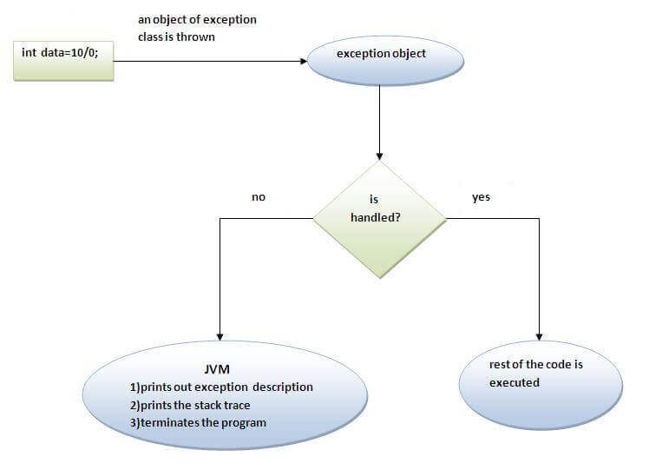
Internal working of java try-catch block

Slide 12
Common Scenarios of Java Exceptions
There are given some scenarios where unchecked exceptions may occur. They are as follows:
1) A scenario where ArithmeticException occurs
If we divide any number by zero, there occurs an ArithmeticException.
int a=50/0;//ArithmeticException
2) A scenario where NullPointerException occurs
If we have a null value in any variable, performing any operation on the variable throws a NullPointerException.
String s=null;
System.out.println(s.length());//NullPointerException

Slide 13
3) A scenario where NumberFormatException occurs
The wrong formatting of any value may occur NumberFormatException. Suppose I have a string variable that has characters, converting this variable into digit will occur NumberFormatException.
String s="abc";
int i=Integer.parseInt(s);//NumberFormatException
4) A scenario where ArrayIndexOutOfBoundsException occurs
If you are inserting any value in the wrong index, it would result in ArrayIndexOutOfBoundsException as shown below:
int a[]=new int[5];
a[10]=50; //ArrayIndexOutOfBoundsException

Slide 14
Problem without exception handling
public class TryCatchExample1
{
public static void main(String[] args)
{
int data=50/0; //may throw exception
System.out.println("rest of the code");
}
}
Output:
Exception in thread "main" java.lang.ArithmeticException: / by zero
As displayed in the above example, the rest of the code is not executed (in such case, the rest of the code statement is not printed).
There can be 100 lines of code after exception. So all the code after exception will not be executed.

Slide 15
Java Exception Handling Example
Let's see an example of Java Exception Handling where we using a try-catch statement to handle the exception.
public class JavaExceptionExample
{
public static void main(String args[])
{
try{
//code that may raise exception
int data=100/0;
}catch(ArithmeticException e){System.out.println(e);}
//rest code of the program
System.out.println("rest of the code...");
}
}

Slide 16
Output:
Exception in thread main java.lang.ArithmeticException:/ by zero
rest of the code...
In the above example, 100/0 raises an ArithmeticException which is handled by a try-catch block.

Slide 17
public class TryCatchExample3
{
public static void main(String[] args) {
try
{
int data=50/0; //may throw exception
// if exception occurs, the remaining statement will not exceute
System.out.println("rest of the code");
}
// handling the exception
catch(ArithmeticException e)
{
System.out.println(e);
}
}
}

Slide 18
Output:
java.lang.ArithmeticException: / by zero
Here, we can see that if an exception occurs in the try block, the rest of the block code will not execute.

Slide 19
displaying the custom message
public class TryCatchExample5 {
public static void main(String[] args) {
try
{
int data=50/0; //may throw exception
}
// handling the exception
catch(Exception e)
{
// displaying the custom message
System.out.println("Can't divided by zero");
}
}
}
Output:
Can't divided by zero

Slide 20
Multiple Catch Blocks
A try block can be followed by multiple catch blocks. The syntax for multiple catch blocks looks like the following −
Syntax
try {
// Protected code
} catch (ExceptionType1 e1) {
// Catch block
} catch (ExceptionType2 e2) {
// Catch block
} catch (ExceptionType3 e3) {
// Catch block
}

Slide 21
Java catch multiple exceptions
Points to remember
At a time only one exception occurs and at a time only one catch block is executed.
All catch blocks must be ordered from most specific to most general, i.e. catch for ArithmeticException must come before catch for Exception.

Slide 22
public class MultipleCatchBlock1 {
public static void main(String[] args) {
try{
int a[]=new int[5];
a[5]=30/0;
}
catch(ArithmeticException e)
{
System.out.println("Arithmetic Exception occurs");
}
catch(ArrayIndexOutOfBoundsException e)
{
System.out.println("ArrayIndexOutOfBounds Exception occurs");
}
catch(Exception e)
{
System.out.println("Parent Exception occurs");
}
System.out.println("rest of the code");
} }
OUTPUT:
Arithmetic Exception occurs
rest of the code

Slide 23
Let's see an example, to handle the exception without maintaining the order of exceptions (i.e. from most specific to most general).
class MultipleCatchBlock5{
public static void main(String args[]){
try{
int a[]=new int[5];
a[5]=30/0;
}
catch(Exception e){System.out.println("common task completed");}
catch(ArithmeticException e){System.out.println("task1 is completed");}
catch(ArrayIndexOutOfBoundsException e){System.out.println("task 2 completed");}
System.out.println("rest of the code...");
}
}
Output:
Compile-time error

Slide 24
Catching Multiple Type of Exceptions
Since Java 7, you can handle more than one exception using a single catch block, this feature simplifies the code. Here is how you would do it −
catch (IOException|FileNotFoundException ex) {
logger.log(ex);
throw ex;
}

Slide 25
Finally
The finally statement lets you execute code, after try...catch, regardless of the result:
public class MyClass {
public static void main(String[] args) {
try {
int[] myNumbers = {1, 2, 3};
System.out.println(myNumbers[10]);
} catch (Exception e) {
System.out.println("Something went wrong.");
} finally {
System.out.println("The 'try catch' is finished.");
}
}
}
The output will be:
Something went wrong.
The 'try catch' is finished.

Slide 26
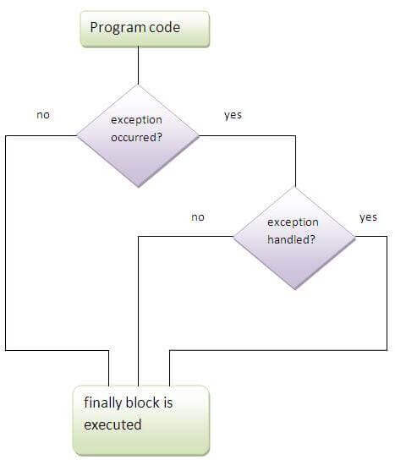
to execute important code such as closing connection, stream etc. always executed whether exception is handled or not. follows try or catch block.
Why use java finally?
Finally block in java can be used to put "cleanup" code such as closing a file, closing connection etc.

Slide 27
Java Nested try block
The try block within a try block is known as nested try block in java.
Why use nested try block?
Sometimes a situation may arise where a part of a block may cause one error and the entire block itself may cause another error. In such cases, exception handlers have to be nested.
Syntax:
....
try
{
statement 1;
statement 2;
try
{
statement 1;
statement 2;
}
catch(Exception e)
{
}
}
catch(Exception e)
{
}
....

Slide 28
class Excep6{
public static void main(String args[]){
try{
try{
System.out.println("going to divide");
int b =39/0;
}catch(ArithmeticException e){System.out.println(e);}
try{
int a[]=new int[5];
a[5]=4;
}catch(ArrayIndexOutOfBoundsException e){System.out.println(e);}
System.out.println("other statement);
}catch(Exception e){System.out.println("handeled");}
System.out.println("normal flow..");
}
}

Slide 29
Java throw exception
Java throw keyword
The Java throw keyword is used to explicitly throw an exception.
We can throw either checked or uncheked exception in java by throw keyword. The throw keyword is mainly used to throw custom exception. We will see custom exceptions later.
The syntax of java throw keyword is given below.
throw exception;

Slide 30
public class TestThrow1{
static void validate(int age){
if(age<18)
throw new ArithmeticException("not valid");
else
System.out.println("welcome to vote");
}
public static void main(String args[]){
validate(13);
System.out.println("rest of the code...");
}
}
Output:
Exception in thread main java.lang.ArithmeticException:not valid

Slide 31
Java throws keyword
The Java throws keyword is used to declare an exception. It gives an information to the programmer that there may occur an exception so it is better for the programmer to provide the exception handling code so that normal flow can be maintained.
Exception Handling is mainly used to handle the checked exceptions. If there occurs any unchecked exception such as NullPointerException, it is programmers fault that he is not performing check up before the code being used.
Syntax of java throws
return_type method_name() throws exception_class_name{
//method code
}

Slide 32
Difference between throw and throws in Java
There are many differences between throw and throws keywords. A list of differences between throw and throws are given below:
throw | throws
1) Java throw keyword is used to explicitly throw an exception. | Java throws keyword is used to declare an exception
2) Checked exception cannot be propagated using throw only. | Checked exception can be propagated with throws.
3) Throw is followed by an instance. | Throws is followed by class.
4) Throw is used within the method. | Throws is used with the method signature.
5) You cannot throw multiple exceptions. | You can declare multiple exceptions e.g. public void method()throws IOException,SQLException.

Slide 33
Difference between final, finally and finalize
There are many differences between final, finally and finalize. A list of differences between final, finally and finalize are given below:
No. | final | finally | finalize
1. | Final is used to apply restrictions on class, method and variable. Final class can't be inherited, final method can't be overridden and final variable value can't be changed. | Finally is used to place important code, it will be executed whether exception is handled or not. | Finalize is used to perform clean up processing just before object is garbage collected.
2. | Final is a keyword. | Finally is a block. | Finalize is a method.

Slide 34
Java Custom Exception
If you are creating your own Exception that is known as custom exception or user-defined exception. Java custom exceptions are used to customize the exception according to user need.
By the help of custom exception, you can have your own exception and message.
Let's see a simple example of java custom exception.

Slide 35
class InvalidAgeException extends Exception{
InvalidAgeException(String s){
super(s);
}
}
class TestCustomException1{
static void validate(int age)throws InvalidAgeException{
if(age<18)
throw new InvalidAgeException("not valid");
else
System.out.println("welcome to vote");
}
public static void main(String args[]){
try{
validate(13);
}catch(Exception m){System.out.println("Exception occured: "+m);}
System.out.println("rest of the code...");
}
}
Output:Exception occured: InvalidAgeException:not valid
rest of the code...

Slide 36
StackTraceElement Example
When a Java virtual machine runs a program, it needs memory to store many things. The memory is organized based on the following need:
Loading classes – Extracts information from class files and stores them in method area.
Creating Objects – As the program runs, JVM creates new objects and places them onto the heap area
Calling Methods – As each new thread comes into existence, it gets its own program counter (pc) and Java stack. The value of the pc register indicates the next instruction to execute. If the thread is executing a Java method, the thread’s Java stack stores the method’s local variables, the parameters with which it was invoked, its return value (if any), and intermediate calculations. All this is put onto the stack
In this article we will see an example of extracting the stack trace elements but before that let’s see Java Stack’s composition and what happens to it when a method is invoked and after it is complete.

Slide 37
Java Stack
The Java stack is composed of stack frames where each frame contains the state of one Java method invocation. When a thread invokes a method, the JVM pushes a new frame onto that thread’s Java stack. When the method completes, the JVM pops and discards the frame for that method.
StackTraceElement Structure
Each stack frame is represented by StackTraceElement. The frame at the top of the stack at the zeroth element represents the execution point at which the stack trace was generated. The last element of the array represents the bottom of the stack, which is the first method invocation in the sequence. Throwable.getStackTrace() provides programmatic access to the stack trace information.
In this example we will use the StackTraceElement array to deduce the main method in the stack trace.

Slide 38
JDK 1.4 added the getStackTrace method to Throwable and this method returns an array of StackTraceElement. The StackTraceElement class provides easy access to information about each stack frame in the stack trace.
There are two obvious uses of the StackTraceElement that come to mind. One is for parsing the contents of an exception stack trace for specific details. The other obvious use of StackTraceElement is to provide metadata when implementing simple logging messages.

Slide 39
The java.lang.StackTraceElement class element represents a single stack frame. All stack frames except for the one at the top of the stack represent a method invocation. The frame at the top of the stack represents the execution point at which the stack trace was generated.
Class Declaration
Following is the declaration for java.lang.StackTraceElement class −
public final class StackTraceElement
extends Object
implements Serializable

Slide 40
Class constructors
StackTraceElement(String declaringClass, String methodName, String fileName, int lineNumber)
This creates a stack trace element representing the specified execution point.

Slide 41
Class methods
boolean equals(Object obj) - This method returns true if the specified object is another StackTraceElement instance representing the same execution point as this instance.
String getClassName() - This method returns the fully qualified name of the class containing the execution point represented by this stack trace element.
String getFileName() - This method returns the name of the source file containing the execution point represented by this stack trace element.
int getLineNumber() - This method returns the line number of the source line containing the execution point represented by this stack trace element.
String getMethodName() - This method returns the name of the method containing the execution point represented by this stack trace element.
int hashCode() - This method returns a hash code value for this stack trace element.
boolean isNativeMethod() - This method returns true if the method containing the execution point represented by this stack trace element is a native method.
String toString() - This method returns a string representation of this stack trace element.

Slide 42
import java.util.Arrays;
public class SomeApplication {
private Class<?> mainClass;
public SomeApplication(Object... sources) {
initialize(sources);
}
private void initialize(Object[] sources) {
mainClass = deriveMainClass();
System.out.println("Initialize application, main class: " + mainClass);
}
public static void launch(Object source, String... args) {
new SomeApplication(new Object[]{source}).run(args);
}
private void run(String[] args) {
System.out.println("Run application with args [" + args + "]");
}

Slide 43
package com.javarticles.concurrency;
private Class<?> deriveMainClass() {
try {
StackTraceElement[] stackTrace = new RuntimeException().getStackTrace();
System.out.println("Stack Trace");
for (Object stack : Arrays.asList(stackTrace)) {
System.out.println(stack);
}
for (StackTraceElement stackTraceElement : stackTrace) {
if ("main".equals(stackTraceElement.getMethodName())) {
return Class.forName(stackTraceElement.getClassName());
}
}
}
catch (ClassNotFoundException ex) {
}
return null;
}
}

Slide 44
Output:
Stack Trace
com.javarticles.concurrency.SomeApplication.deriveMainClass(SomeApplication.java:26)
com.javarticles.concurrency.SomeApplication.initialize(SomeApplication.java:12)
com.javarticles.concurrency.SomeApplication.(SomeApplication.java:8)
com.javarticles.concurrency.SomeApplication.launch(SomeApplication.java:17)
com.javarticles.concurrency.StackTraceElementExample.main(StackTraceElementExample.java:6)
Initialize application, main class: class com.javarticles.concurrency.StackTraceElementExample
Run application with args [[Ljava.lang.String;@15db9742]

Slide 45
Java I/O
Java I/O (Input and Output) is used to process the input and produce the output.
Java uses the concept of a stream to make I/O operation fast. The java.io package contains all the classes required for input and output operations.
We can perform file handling in Java by Java I/O API.

Slide 46
Java performs I/O through Streams. A Stream is linked to a physical layer by java I/O system to make input and output operation in java. In general, a stream means continuous flow of data. Streams are clean way to deal with input/output without having every part of your code understand the physical.
Java encapsulates Stream under java.io package. Java defines two types of streams. They are,
Byte Stream : It provides a convenient means for handling input and output of byte.
Character Stream : It provides a convenient means for handling input and output of characters. Character stream uses Unicode and therefore can be internationalized.

Slide 47
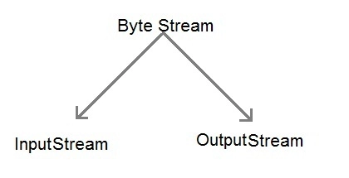
Java Byte Stream Classes
Byte stream is defined by using two abstract class at the top of hierarchy, they are InputStream and OutputStream.
byte stream classification
These two abstract classes have several concrete classes that handle various devices such as disk files, network connection etc.

Slide 48
Some important Byte stream classes.
Stream class Description
BufferedInputStream Used for Buffered Input Stream.
BufferedOutputStream Used for Buffered Output Stream.
DataInputStream Contains method for reading java standard datatype
DataOutputStream An output stream that contain method for writing java standard data type
FileInputStream Input stream that reads from a file
FileOutputStream Output stream that write to a file.
InputStream Abstract class that describe stream input.
OutputStream Abstract class that describe stream output.
PrintStream Output Stream that contain print() and println() method
These classes define several key methods. Two most important are
read() : reads byte of data.
write() : Writes byte of data.

Slide 49
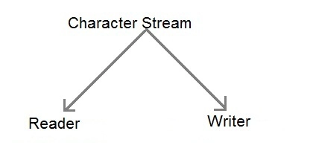
Java Character Stream Classes
Character stream is also defined by using two abstract class at the top of hierarchy, they are Reader and Writer.
character stream classification
These two abstract classes have several concrete classes that handle unicode character.

Slide 50
Some important Charcter stream classes
Stream class Description
BufferedReader Handles buffered input stream.
BufferedWriter Handles buffered output stream.
FileReader Input stream that reads from file.
FileWriter Output stream that writes to file.
InputStreamReader Input stream that translate byte to character
OutputStreamReader Output stream that translate character to byte.
PrintWriter Output Stream that contain print() and println() method.
Reader Abstract class that define character stream input
Writer Abstract class that define character stream output

Slide 51
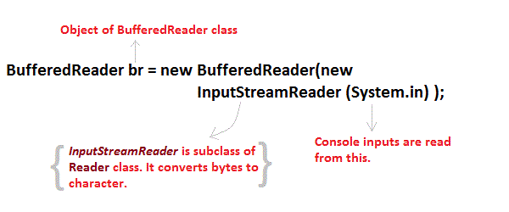
Reading Console Input
We use the object of BufferedReader class to take inputs from the keyboard.
BufferedReader class explanation

Slide 52
Reading Characters
read() method is used with BufferedReader object to read characters. As this function returns integer type value has we need to use typecasting to convert it into char type.
int read() throws IOException
Below is a simple example explaining character input.
class CharRead
{
public static void main( String args[])
{
BufferedReader br = new Bufferedreader(new InputstreamReader(System.in));
char c = (char)br.read(); //Reading character
}
}

Slide 53
Reading Strings in Java
To read string we have to use readLine() function with BufferedReader class's object.
String readLine() throws IOException
Program to take String input from Keyboard in Java
import java.io.*;
class MyInput
{
public static void main(String[] args)
{
String text;
InputStreamReader isr = new InputStreamReader(System.in);
BufferedReader br = new BufferedReader(isr);
text = br.readLine(); //Reading String
System.out.println(text);
}
}

Slide 54
Program to read from a file using BufferedReader class
import java. Io *;
class ReadTest {
public static void main(String[] args) {
try {
File fl = new File("d:/myfile.txt");
BufferedReader br = new BufferedReader(new FileReader(fl)) ;
String str;
while ((str=br.readLine())!=null) {
System.out.println(str);
}
br.close();
fl.close();
}
catch(IOException e) {
e.printStackTrace();
} } }

Slide 55
Program to write to a File using FileWriter class
import java. Io *;
class WriteTest
{
public static void main(String[] args)
{
try
{
File fl = new File("d:/myfile.txt");
String str="Write this string to my file";
FileWriter fw = new FileWriter(fl) ;
fw.write(str);
fw.close();
fl.close();
}
catch (IOException e)
{ e.printStackTrace(); }
}
}

Slide 56
Stream
A stream is a sequence of data. In Java, a stream is composed of bytes. It's called a stream because it is like a stream of water that continues to flow.
In Java, 3 streams are created for us automatically. All these streams are attached with the console.
1) System.out: standard output stream
2) System.in: standard input stream
3) System.err: standard error stream

Slide 57
Let's see the code to print output and an error message to the console.
System.out.println("simple message");
System.err.println("error message");
Let's see the code to get input from console.
int i=System.in.read();//returns ASCII code of 1st character
System.out.println((char)i);//will print the character

Slide 58
OutputStream vs InputStream
The explanation of OutputStream and InputStream classes are given below:
OutputStream
Java application uses an output stream to write data to a destination; it may be a file, an array, peripheral device or socket.
InputStream
Java application uses an input stream to read data from a source; it may be a file, an array, peripheral device or socket.

Slide 59
Java IO
OutputStream class
OutputStream class is an abstract class. It is the superclass of all classes representing an output stream of bytes. An output stream accepts output bytes and sends them to some sink.

Slide 60
working of Java OutputStream and InputStream

Slide 61
Useful methods of OutputStream
1) public void write(int)throws IOException - is used to write a byte to the current output stream.
2) public void write(byte[])throws IOException - is used to write an array of byte to the current output stream.
3) public void flush()throws IOException - flushes the current output stream.
4) public void close()throws IOException - is used to close the current output stream.

Slide 62
OutputStream Hierarchy

Slide 63
InputStream class
InputStream class is an abstract class. It is the superclass of all classes representing an input stream of bytes.
Useful methods of InputStream
1) public abstract int read()throws IOException - reads the next byte of data from the input stream. It returns -1 at the end of the file.
2) public int available()throws IOException - returns an estimate of the number of bytes that can be read from the current input stream.
3) public void close()throws IOException - is used to close the current input stream.

Slide 64
InputStream Hierarchy

Slide 65
Java FileOutputStream Class
Java FileOutputStream is an output stream used for writing data to a file.
If you have to write primitive values into a file, use FileOutputStream class. You can write byte-oriented as well as character-oriented data through FileOutputStream class. But, for character-oriented data, it is preferred to use FileWriter than FileOutputStream.

Slide 66
FileOutputStream class declaration
Let's see the declaration for Java.io.FileOutputStream class:
public class FileOutputStream extends OutputStream

Slide 68
FileOutputStream class methods
protected void finalize()- It is used to clean up the connection with the file output stream.
void write(byte[] ary)- It is used to write ary.length bytes from the byte array to the file output stream.
void write(byte[] ary, int off, int len) - It is used to write len bytes from the byte array starting at offset off to the file output stream.
void write(int b) - It is used to write the specified byte to the file output stream.
FileChannel getChannel() - It is used to return the file channel object associated with the file output stream.
FileDescriptor getFD() - It is used to return the file descriptor associated with the stream.
void close() - It is used to closes the file output stream.

Slide 69
Java FileOutputStream Example 1: write byte
import java.io.FileOutputStream;
public class FileOutputStreamExample {
public static void main(String args[]){
try{
FileOutputStream fout=new FileOutputStream("D:\\testout.txt");
fout.write(65);
fout.close();
System.out.println("success...");
}catch(Exception e){System.out.println(e);}
}
}
Output:
Success...
The content of a text file testout.txt is set with the data A.
testout.txt
A

Slide 70
Java FileOutputStream example 2: write string
import java.io.FileOutputStream;
public class FileOutputStreamExample {
public static void main(String args[]){
try{
FileOutputStream fout=new FileOutputStream("D:\\testout.txt");
String s="Welcome to javaTpoint.";
byte b[]=s.getBytes();//converting string into byte array
fout.write(b);
fout.close();
System.out.println("success...");
}catch(Exception e){System.out.println(e);}
}
}
Output:
Success...
The content of a text file testout.txt is set with the data Welcome to java.
testout.txt
Welcome to java.

Slide 71
Java FileInputStream Class
Java FileInputStream class obtains input bytes from a file. It is used for reading byte-oriented data (streams of raw bytes) such as image data, audio, video etc. You can also read character-stream data. But, for reading streams of characters, it is recommended to use FileReader class.
Java FileInputStream class declaration
public class FileInputStream extends InputStream

Slide 72
Java FileInputStream class methods
int available() - It is used to return the estimated number of bytes that can be read from the input stream.
int read() - It is used to read the byte of data from the input stream.
int read(byte[] b)- It is used to read up to b.length bytes of data from the input stream.
int read(byte[] b, int off, int len)- It is used to read up to len bytes of data from the input stream.
long skip(long x)- It is used to skip over and discards x bytes of data from the input stream.
FileChannel getChannel()- It is used to return the unique FileChannel object associated with the file input stream.
FileDescriptor getFD()- It is used to return the FileDescriptor object.
protected void finalize()- It is used to ensure that the close method is call when there is no more reference to the file input stream.
void close() - It is used to closes the stream.

Slide 73
Java FileInputStream example 1: read single character
import java.io.FileInputStream;
public class DataStreamExample {
public static void main(String args[]){
try{
FileInputStream fin=new FileInputStream("D:\\testout.txt");
int i=fin.read();
System.out.print((char)i);
fin.close();
}catch(Exception e){System.out.println(e);}
}
}
Note: Before running the code, a text file named as "testout.txt" is required to be created. In this file, we are having following content:

Slide 74
Welcome to javatpoint.
After executing the above program, you will get a single character from the file which is 87 (in byte form). To see the text, you need to convert it into character.
Output:
W

Slide 75
Java FileInputStream example 2: read all characters
package com.javatpoint;
import java.io.FileInputStream;
public class DataStreamExample {
public static void main(String args[]){
try{
FileInputStream fin=new FileInputStream("D:\\testout.txt");
int i=0;
while((i=fin.read())!=-1){
System.out.print((char)i);
}
fin.close();
}catch(Exception e){System.out.println(e);}
}
}
Output:
Welcome to javaTpoint

Slide 76
import java.io.*;
public class ReadConsole {
public static void main(String args[]) throws IOException {
InputStreamReader cin = null;
try {
cin = new InputStreamReader(System.in);
System.out.println("Enter characters, 'q' to quit.");
char c;
do {
c = (char) cin.read();
System.out.print(c);
} while(c != 'q');
}finally {
if (cin != null) {
cin.close();
} } } }

Slide 77
$javac ReadConsole.java
$java ReadConsole
Enter characters, 'q' to quit.
1
1
e
e
q
q

